Slide 1
RANSOMWARE ANALYSIS

Slide 2
Ransomware
Ransomware is a type of malware that encrypts or blocks access to a victim's files or computer system.
Attackers demand a ransom payment in exchange for restoring access to the files or system.
Ransomware typically spreads through phishing emails which has email attachments, malicious links, or software vulnerabilities.

Slide 3
How does a ransomware attack work?
[attacker→victim] The attacker generates a key pair and places the corresponding public key in the malware. The malware is released.
[victim→attacker] To carry out the crypto-viral extortion attack, the malware generates a random symmetric key and encrypts the victim's data with it. It uses the public key in the malware to encrypt the symmetric key. This is known as hybrid encryption, and it results in a small asymmetric ciphertext as well as the symmetric ciphertext of the victim's data. It zeroes the symmetric key and the original plaintext data to prevent recovery. It puts up a message to the user that includes the asymmetric ciphertext and how to pay the ransom. The victim sends the asymmetric ciphertext and e-money to the attacker.
[attacker→victim] The attacker receives the payment, deciphers the asymmetric ciphertext with the attacker's private key, and sends the symmetric key to the victim. The victim deciphers the encrypted data with the needed symmetric key thereby completing the cryptovirology attack.

Slide 4
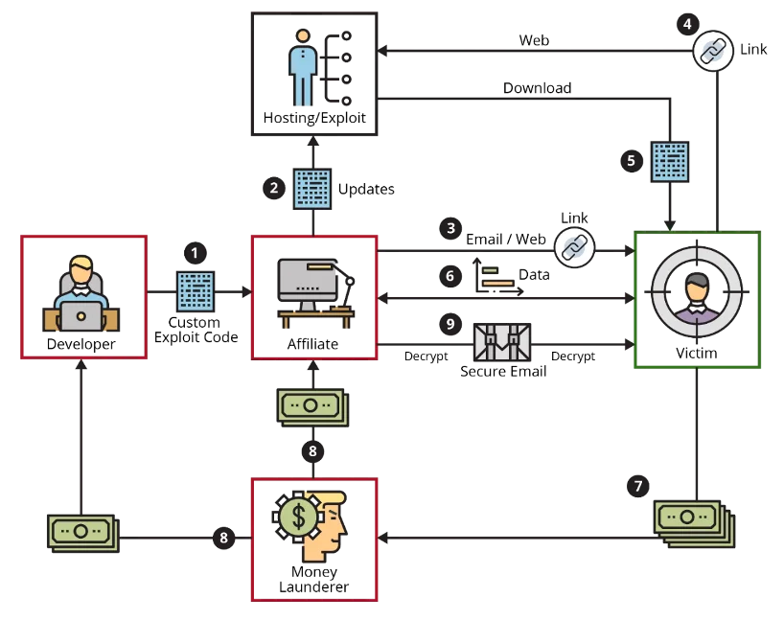
Ransomware-as-a-service

Slide 5
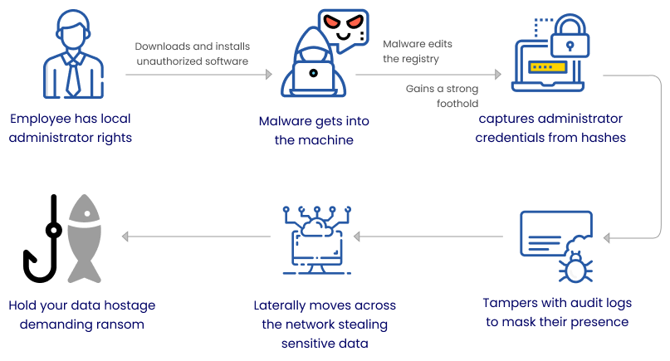
What our work will be targeting?

Slide 6
Dynamic Feature Dataset for Ransomware Detection Using Machine Learning Algorithms By Juan A. Herrera-Silva and Myriam Hernández-Álvarez
Notes:
Published January 2023 so pretty latest

Slide 7
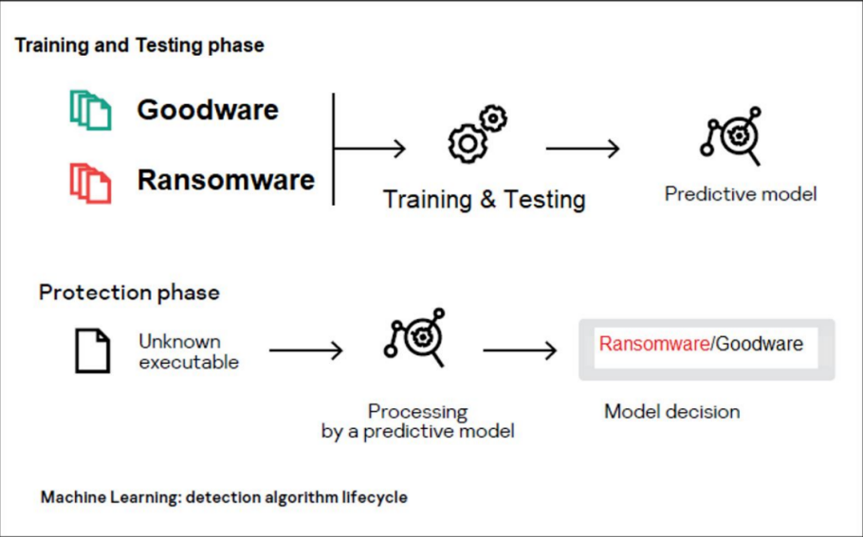

Slide 8
How did they approach Ransomware Analysis?
Executed experiments with Encryptor and Locker ransomware combined with goodware to generate JSON files with dynamic parameters using Cuckoo sandbox.
Used dynamic analysis and machine learning to identify the ransomware signatures using selected dynamic features.
They analyzed and selected the most relevant and non-redundant dynamic features for identifying and differentiating encryptor and locker ransomware from Goodware’s 50 most important characteristics pertaining to their analysis.
The final feature dataset is composed of 2000 registers of 50 characteristics each. This dataset allows for machine learning detection with a 10-fold cross-evaluation with an average accuracy superior to 0.99 for gradient-boosted regression trees, random forests, and neural networks.
Notes:
They used Random Forest, Gradient Boosted Trees, Naïve Bayes and Neural Networks for their analysis.

Slide 9
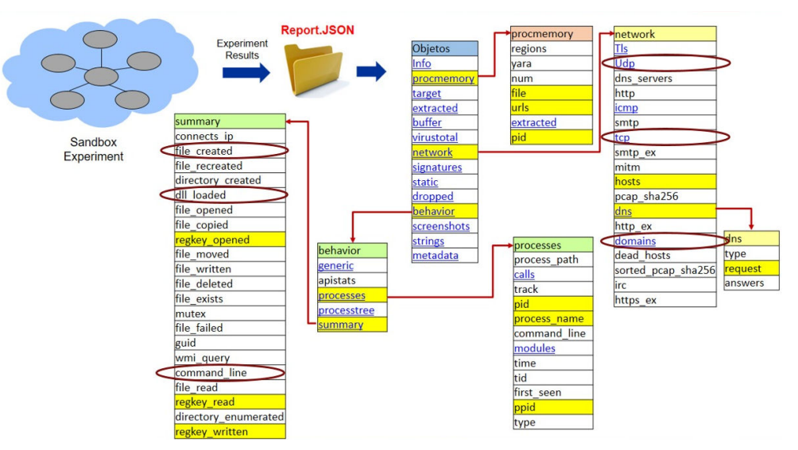

Slide 10
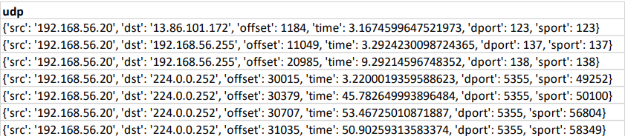

Slide 11
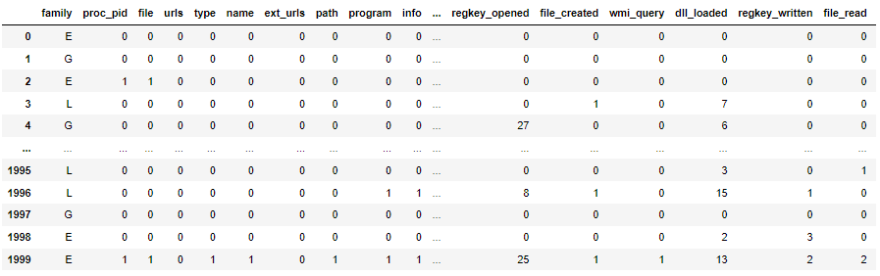

Slide 12
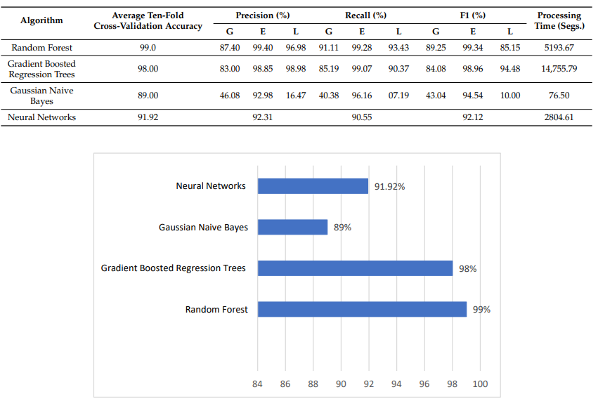
Results

Slide 13
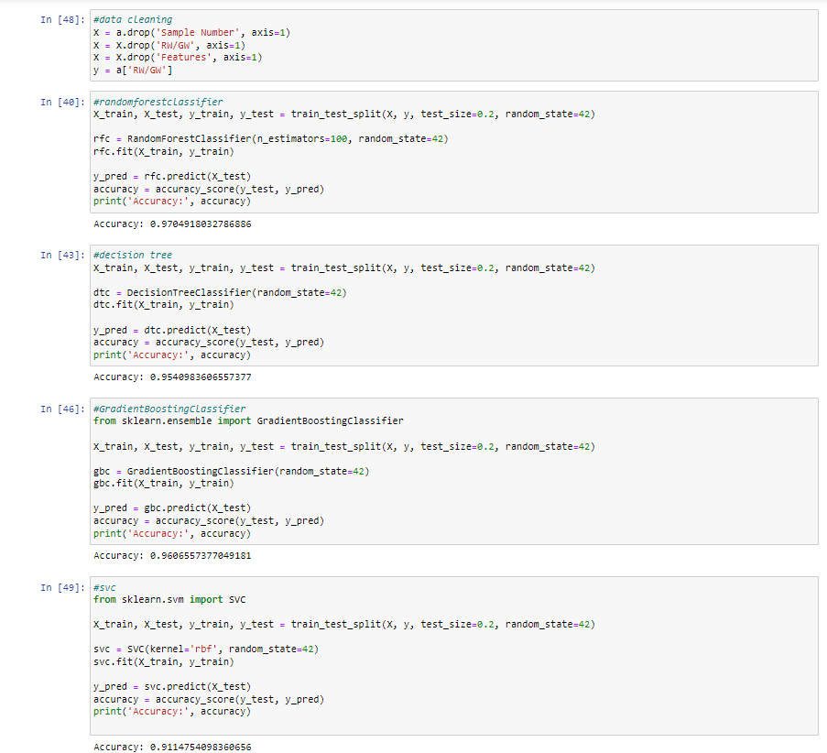

Slide 14
What are we doing here in this project then?

Slide 15
Ransomware Samples
Darkside v2.1
WannaCry
Cryptolocker
petya

Slide 16
Sources
Clear web – legit sources
Dark web – underground sources

Slide 17
Sources from the clear web
https://www.vx-underground.org/
https://github.com/ytisf/theZoo
https://malshare.com/
https://malware.one/
https://beta.virusbay.io/login
https://vxug.fakedoma.in/
https://www.virustotal.com/gui/home/search
https://virusshare.com/

Slide 18
Sources from the Dark Web
Sources at https://www.reddit.com/r/Malware/comments/qhse7t/list_of_ransomware_groups_and_their_pr_pages_2021/

Slide 19
Analysis of the Ransomware Samples

Slide 20
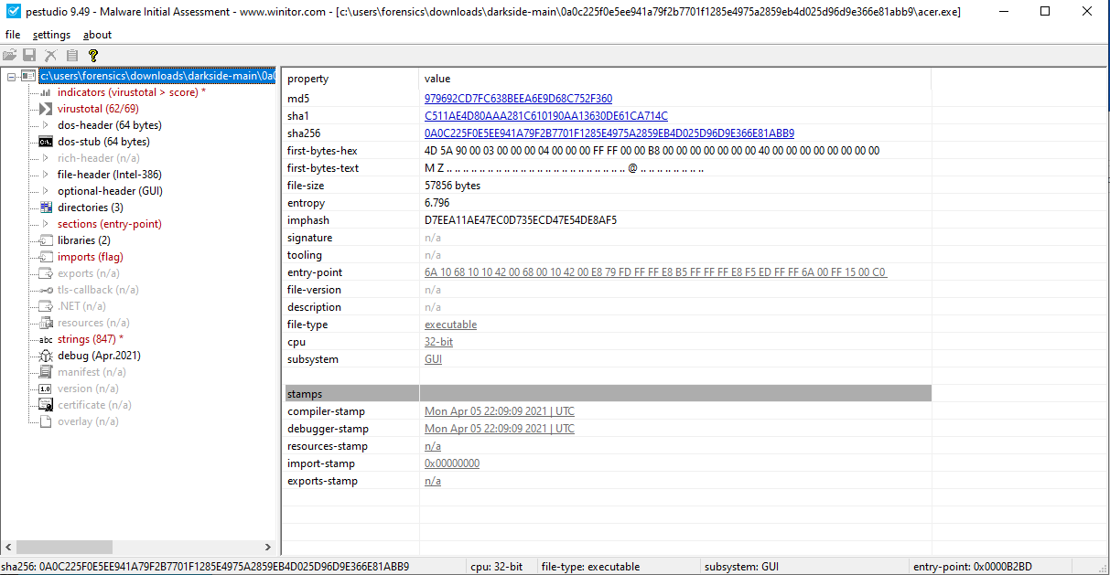
Static Analysis
Notes:
There is a whole different field attached to be doing malware static analysis – reverse engineering. One such example is at https://cybergeeks.tech/a-step-by-step-analysis-of-a-new-version-of-darkside-ransomware/

Slide 21
Dynamic Analysis
Analyzing malware by actually running it, and analyzing its behaviors such as API calls, memory usage, network traffic, etc.(Cuckoo is a dynamic malware analysis tool).
Execution of the ransomware in a controlled environment:
Cuckoo Sandbox

Slide 22

Configuration and Installation of Cuckoo Sandbox

Slide 23
Step-by-step guide
https://utopianknight.com/malware/cuckoo-installation-on-ubuntu-20/

Slide 24
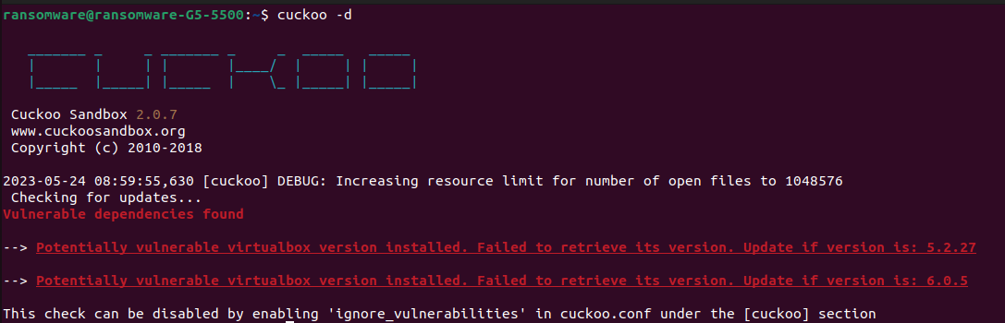
Cuckoo Sandbox

Slide 25
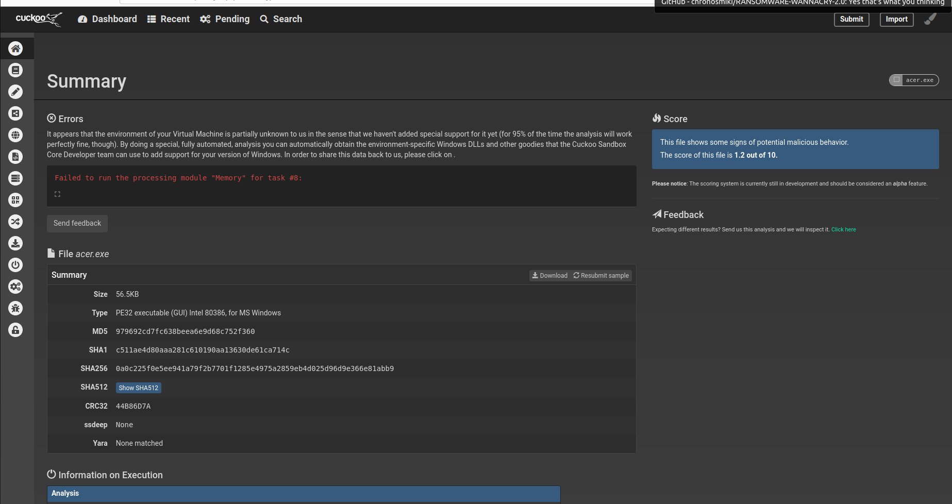
Darkside v2.1 ransomware

Slide 26
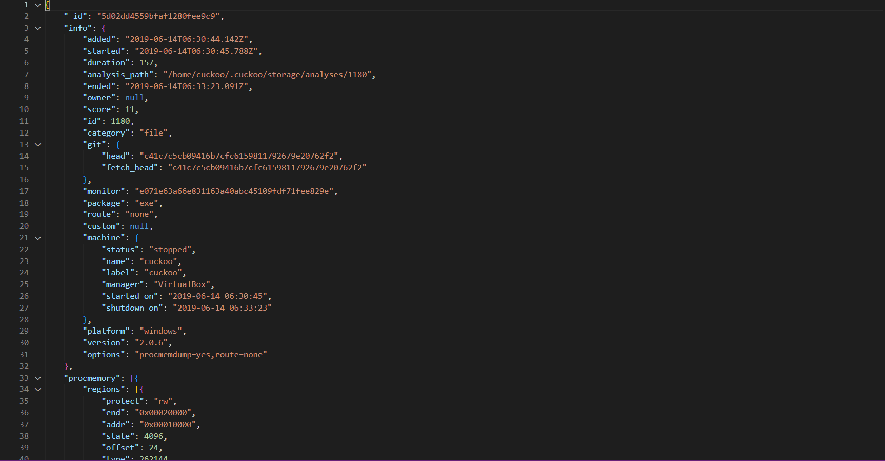
Obtained JSON File - Example
Notes:
Create a json dataset and then use the previous paper to segregate the json file into usable csv file

Slide 27
Datasets
Dynamic Feature Dataset
RanSAP
EldeRan

Slide 28
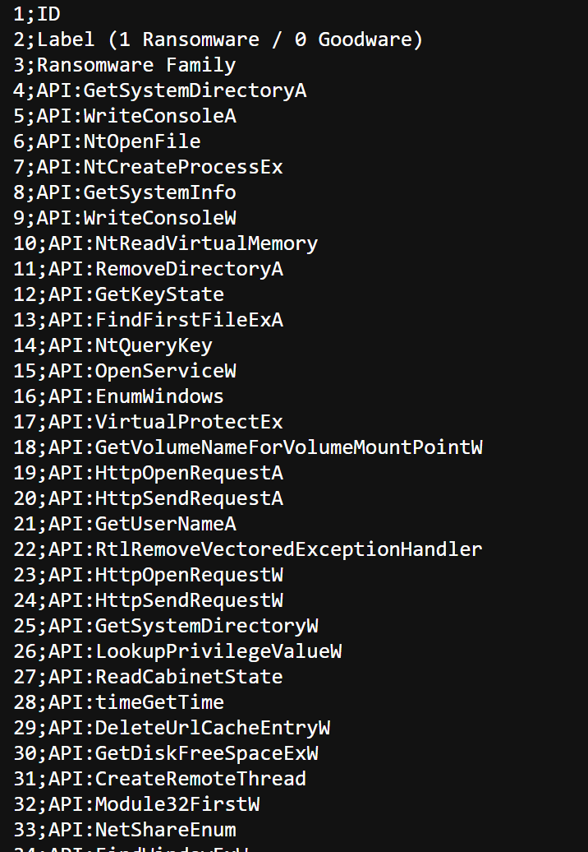
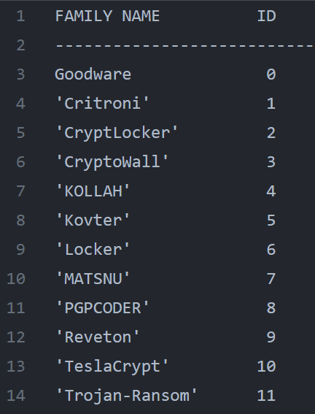
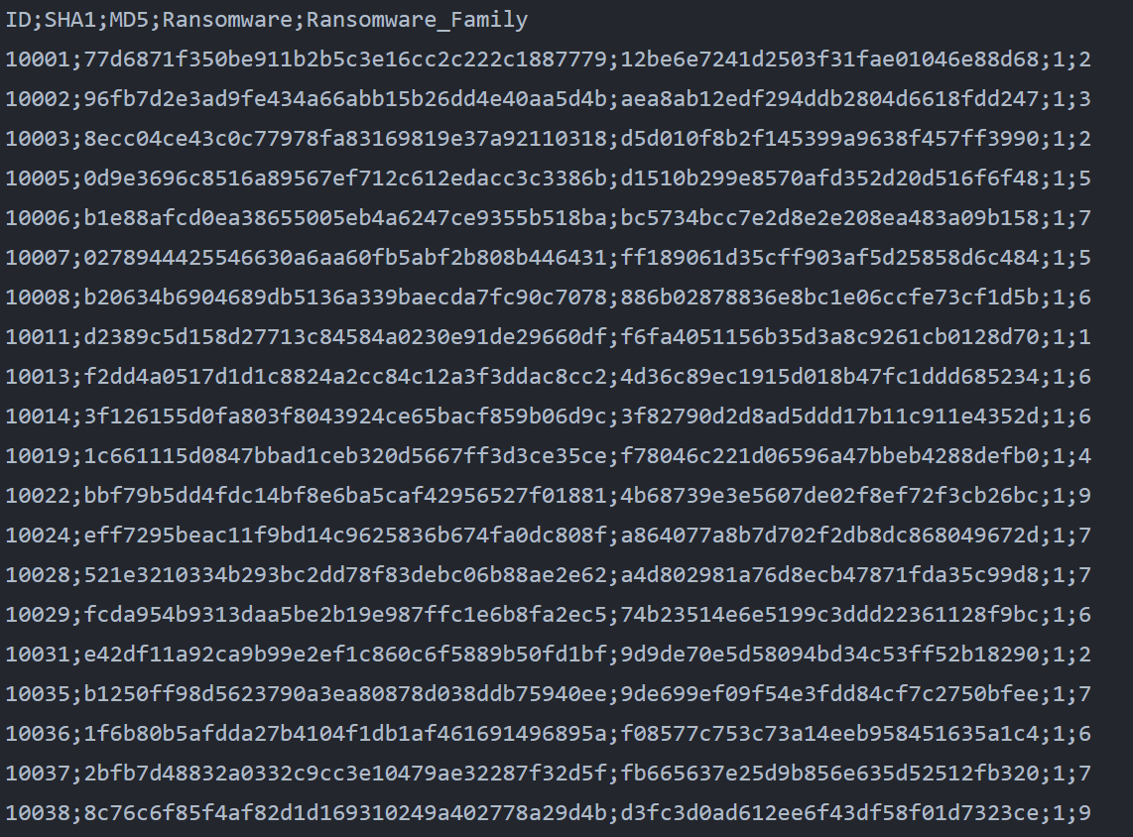
Elderan – Ransomware Feature dataset
Notes:
2016

Slide 29
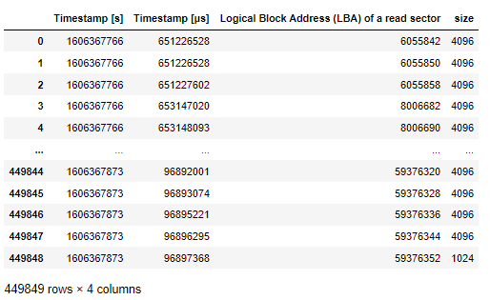
RanSAP - An Open Dataset of Ransomware Storage Access Patterns
Timestamp [s]
Timestamp [μs]
Logical Block Address (LBA) of the location being accessed by the ransomware
Size of a block accessed by the sample [byte]

Slide 30
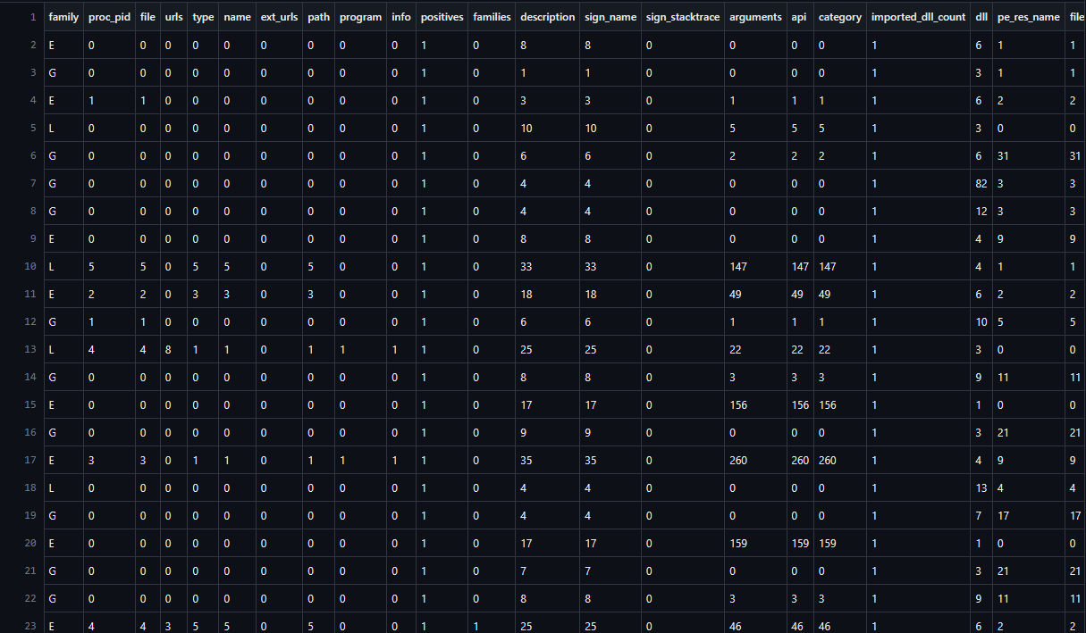
Dynamic Feature Dataset for Ransomware Detection

Slide 31
Analysis of the obtained features
Machine learning
Deep learning using pytorch
Graph based analysis
GCN – Graph Convolutional Networks

Slide 32
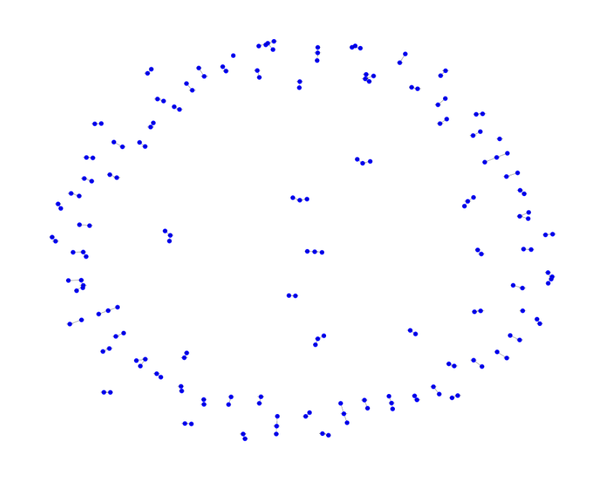
Plotting the RanSAP dataset as a networkx graph

Slide 33
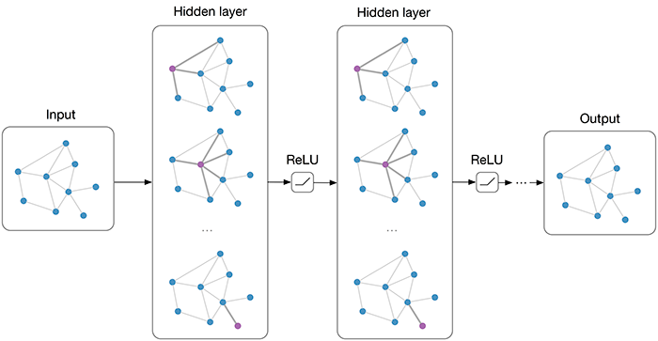
Graph Convolutional Networks

Slide 34
Graph Convolutional Networks
Graph Representation: First, we represent our data as a graph, where nodes represent instances or entities, and edges represent relationships or connections between them. Each node may have associated features or attributes.
Graph Convolutional Layers: We stack multiple graph convolutional layers to create the GCN model. Each layer consists of two key steps: message passing and aggregation. During message passing, nodes gather information from their neighboring nodes by applying a linear transformation to their features. In the aggregation step, the information from neighboring nodes is combined, typically through a summation or pooling operation.
Non-linear Activation: After each graph convolutional layer, we apply a non-linear activation function, such as ReLU (Rectified Linear Unit), to introduce non-linearity and enable the model to learn complex relationships.
Pooling and Downsampling: If needed, we can incorporate pooling or downsampling layers to reduce the dimensionality of the graph representations, capturing higher-level abstractions while preserving important information.
Fully Connected Layers: Following the graph convolutional layers, we can add one or more fully connected layers. These layers enable the model to learn higher-level representations and perform classification.
Output Layer and Loss Function: The final layer is typically a single-node output layer with a sigmoid activation function. It produces a probability score representing the likelihood of belonging to one of the binary classes. The loss function used for training is often binary cross-entropy, which measures the dissimilarity between predicted probabilities and true binary labels.
Training and Optimization: We train the GCN model using labeled data, optimizing the model's parameters using gradient-based optimization methods, such as stochastic gradient descent (SGD) or Adam optimizer. The model is trained to minimize the loss function by adjusting the weights and biases in the layers.
Prediction and Evaluation: Once trained, the GCN model can make predictions on new, unlabeled graph data. The predicted probability scores can be thresholded to assign binary labels (e.g., 0 or 1) and evaluate the performance of the binary classifier using metrics like accuracy, precision, recall, or F1 score.

Slide 35
Graphlet Sampling
Graphlet sampling refers to a technique used in graph analysis to extract and analyze small subgraphs, known as graphlets, from a larger graph. Graphlets are essentially small connected subgraphs with a fixed number of nodes, and they provide insights into the local structural patterns and connectivity within a graph.
Graphlet sampling involves randomly selecting nodes or edges from a given graph and constructing subgraphs around them. The selection process can be performed with various sampling strategies, such as random node sampling, edge sampling, or biased sampling based on node degree or other graph properties. Once the subgraphs are sampled, various graph metrics and algorithms can be applied to analyze their properties and understand the local structural characteristics of the graph.
Graphlet sampling has several applications in graph analysis, such as studying community structure, identifying important nodes or motifs, detecting anomalies or patterns, and measuring graph similarity. By focusing on small subgraphs, graphlet sampling provides a scalable approach to extract meaningful information from large graphs and offers insights into the local interactions and connectivity patterns that might be overlooked at the global graph level.
Overall, graphlet sampling is a valuable technique in graph analysis that allows researchers to explore and understand the structural characteristics of complex networks by extracting and analyzing small, representative subgraphs.

